Slide 1
PROJECT TITLE Steganography – Hiding Information in an Image
CAPSTONE PROJECT
Presented By:
M LAKSHMI GANESH
SRM INSTITUTE OF SCIENCE AND TECHNOLOGY
COMPUTER SCIENCE AND ENGINEERING – CSE

Slide 2
OUTLINE
Problem Statement (Should not include solution)
System Development Approach (Technology Used)
Algorithm & Deployment (Step by Step Procedure)
Result
Conclusion
Future Scope(Optonal)
References

Slide 3
Problem Statement
In today's digital world, secure communication of sensitive data is essential. Traditional encryption methods make data unreadable but still visible. Steganography offers a way to hide the existence of data itself. This project focuses on hiding secret messages inside images using the Least Significant Bit (LSB) technique. The goal is to embed and extract data without altering the visible quality of the image.

Slide 4
System Approach
Input Phase:
User selects a cover image (e.g., PNG file).
User types the secret message to be hidden.
Encoding Phase:
The message is converted into binary format.
Each bit of the message is embedded into the least significant bit (LSB) of the image’s RGB pixel values.
A delimiter is added to mark the end of the message.
Output Phase (Stego Image):
The modified image, now carrying the hidden message, is saved as the output (visually unchanged).
Decoding Phase:
The stego image is loaded.
LSBs are read and combined to retrieve the binary data.
The binary message is converted back to readable text until the delimiter is found.
Result Display:
The hidden message is displayed to the user securely and accurately.

Slide 5
Algorithm & Deployment
Algorithm
Encoding Algorithm (Hiding the Message)
Input the cover image and the secret message.
Convert the secret message into binary format.
Append a delimiter (e.g., 1111111111111110) to the binary message to signal the end.
Load the image and convert it to RGB pixel values.
Replace the least significant bit (LSB) of each RGB component with each bit of the binary message.
Save the modified image as the stego image.
Deployment
Deployment Setup (for local use)
System Requirements:
Python 3.x installed
Required libraries: Pillow, NumPy
Optional: Tkinter for GUI
Steps to Deploy:
Install dependencies:bash
CopyEdit
pip install pillow numpy
Save the Python script (steganography.py).
Prepare a PNG image as input.
Run the script:bash
CopyEdit
python steganography.py
Test both encoding and decoding functions.
Output:
Encoded image saved to disk.
Hidden message successfully retrieved and displayed.

Slide 6
Result
Attach screen snaps of the code and output min 5
Attach your Github link
https://github.com/Ganesh813-eng/Steganography-Hiding-Information-in-image/blob/main/README.md

Slide 7
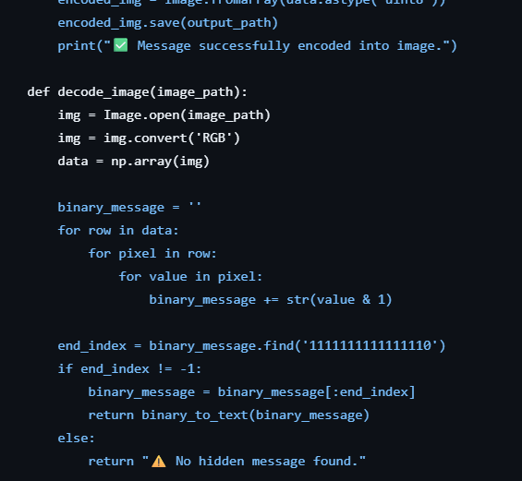
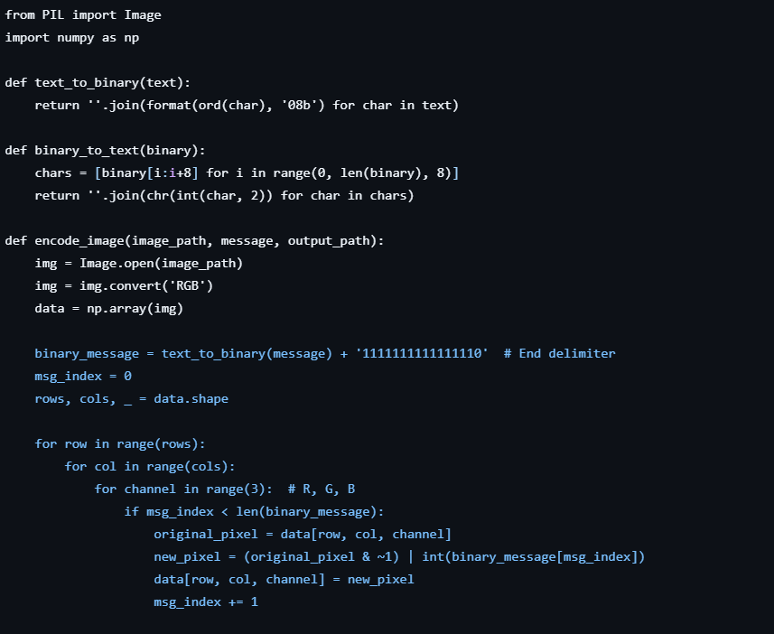
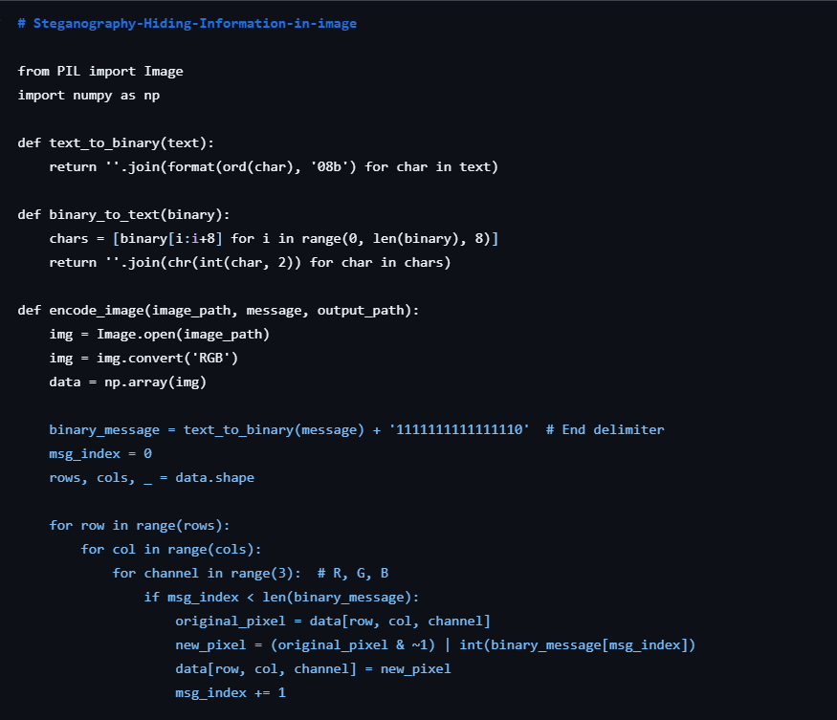
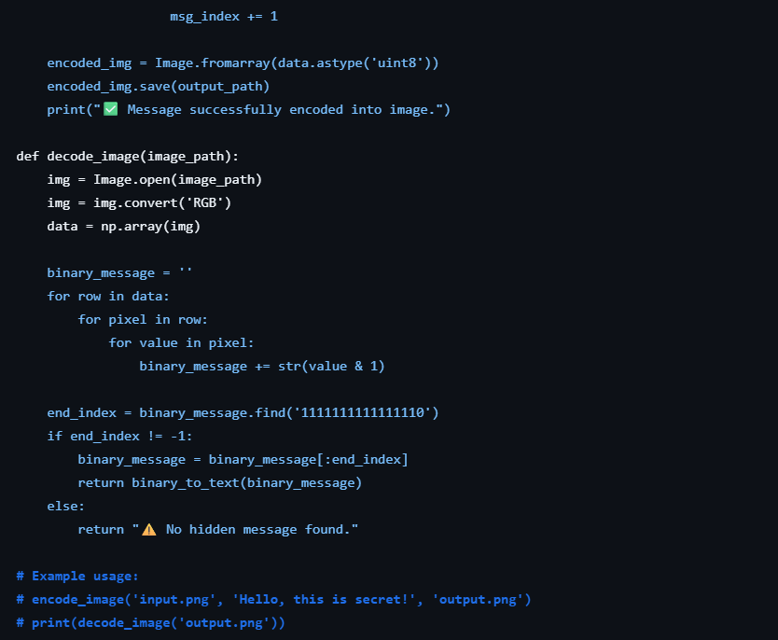
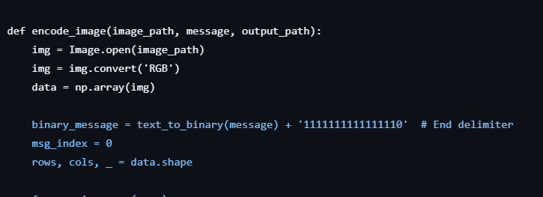

Slide 8
Conclusion
Summarize the findings and discuss the effectiveness of the proposed solution. Highlight any challenges encountered during the implementation and potential improvements.

Slide 9
Future scope(Optional)
Enhanced Security through Encryption:
Combine steganography with cryptographic techniques (e.g., AES) to encrypt the message before hiding it, adding an extra layer of protection.
Support for Multimedia Files:
Extend the system to hide data in audio and video files, not just images, for broader applications.
Robustness Against Image Compression:
Develop advanced techniques (e.g., DCT or DWT-based steganography) to make the hidden data resistant to lossy compression and format conversion.
Steganalysis Resistance:
Implement anti-detection mechanisms to prevent steganalysis tools from discovering the presence of hidden data.
User Interface Development:
Build a cross-platform GUI application or web tool to make the system user-friendly for non-technical users.

Slide 10
References
Johnson, N. F., & Jajodia, S. (1998). Exploring Steganography: Seeing the Unseen. IEEE Computer, 31(2), 26–34. https://doi.org/10.1109/2.658917
Katzenbeisser, S., & Petitcolas, F. A. (2000). Information Hiding Techniques for Steganography and Digital Watermarking. Artech House.
Provos, N., & Honeyman, P. (2003). Hide and Seek: An Introduction to Steganography. IEEE Security & Privacy, 1(3), 32–44. https://doi.org/10.1109/MSECP.2003.1203220
Python Imaging Library (Pillow) Documentation – https://pillow.readthedocs.io/
NumPy Documentation – https://numpy.org/doc/
IBM SkillsBuild & Edunet Foundation – Internship materials and guided project frameworks.

Slide 11
THANK YOU

